Slide 1
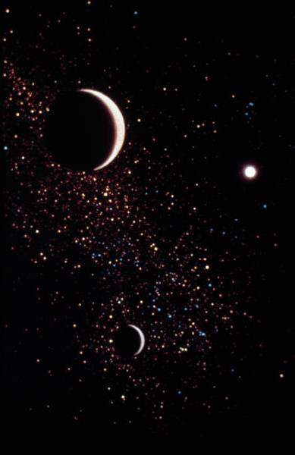
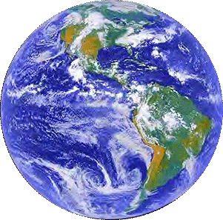
How did the Universe begin?
Was it created by God?

Slide 2
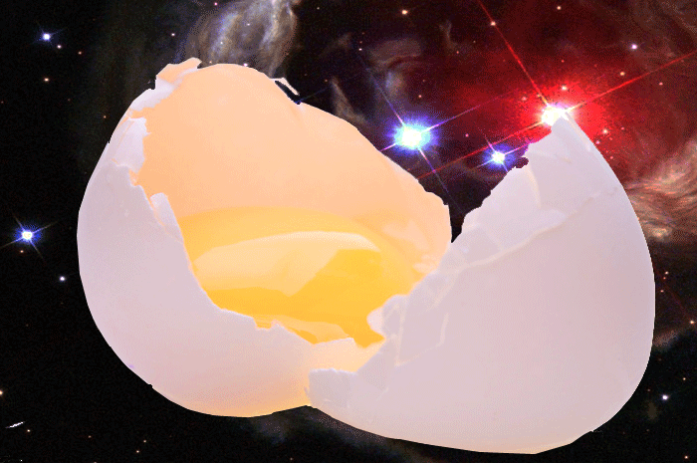
Would You Believe It?
If you’d been told by your parents that the Universe came out of an egg, would you believe it?

Slide 3
Would You Believe It?
If you were born in China or India many years ago, this is what the adults would tell you – and guess what - you would probably have believed it too

Slide 4
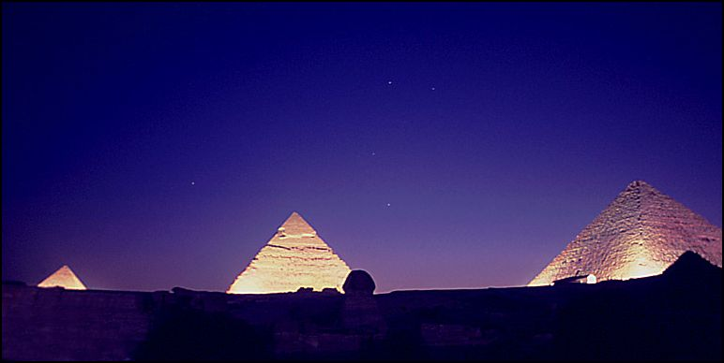
But in Egypt people believed something different. They believed that the stars first appeared when the sky god, Nut, arched over the ground.
What is an animal with two humps, which lives at the North Pole
A lost camel!

Slide 5
When comparing science with religion, you could take one of these approaches:
You believe EVERYTHING about creation in religious scripture. When scientists say something different, you say they are mistaken.
Religion only
You believe NOTHING about creation from religion. You only listen to what scientists tell us.
Science only
Open to both science and religion
You take ideas from both religion and science, believing that together they give you a bigger picture.

Slide 6
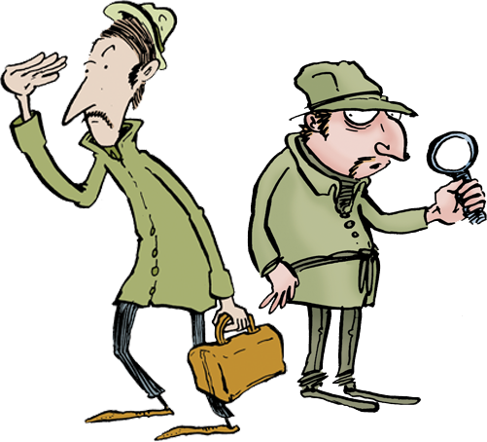
Some people say that if you compare what science says about the beginning of the Universe with what the Bible says, science proves the Biblical story untrue. But others say they fit together... We look at why, with the ...
The Creation
Sleuths!

Slide 7

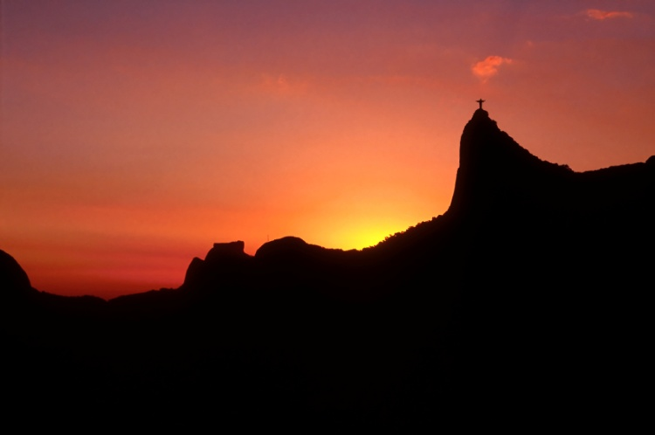
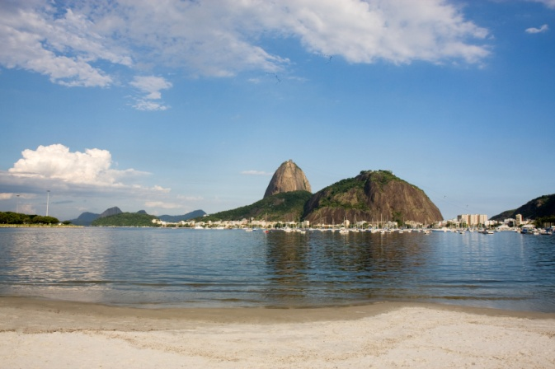
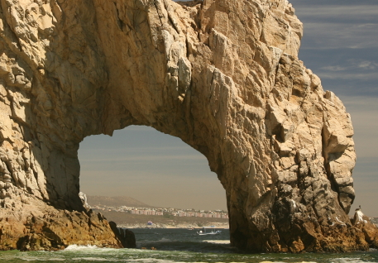
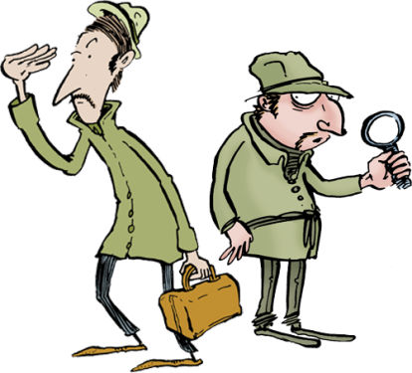
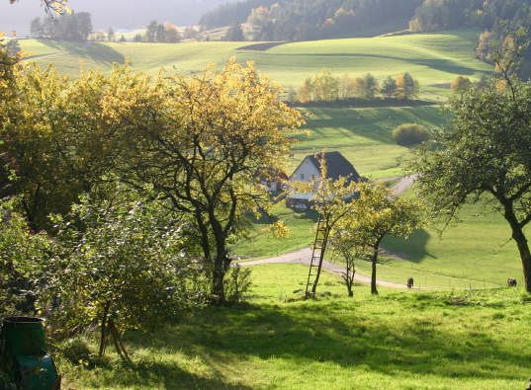
Step 1: look at what the story says
In the beginning God created the heavens and the earth. On the second day He separated the sky from the Earth. On the third day, He created plants. On the fourth day, God made two great lamps, one to govern the day and a lesser lamp to govern the night. Day by day, the Earth took shape. Something new each day.

Slide 8
OK, sleuths ... Question 1:
In the Bible, it says that God made the Universe in six days.
This is surely a conflict with science, isn’t it?
So did the writer of the story make a mistake or is there another reason why the wording is like this?

Slide 9
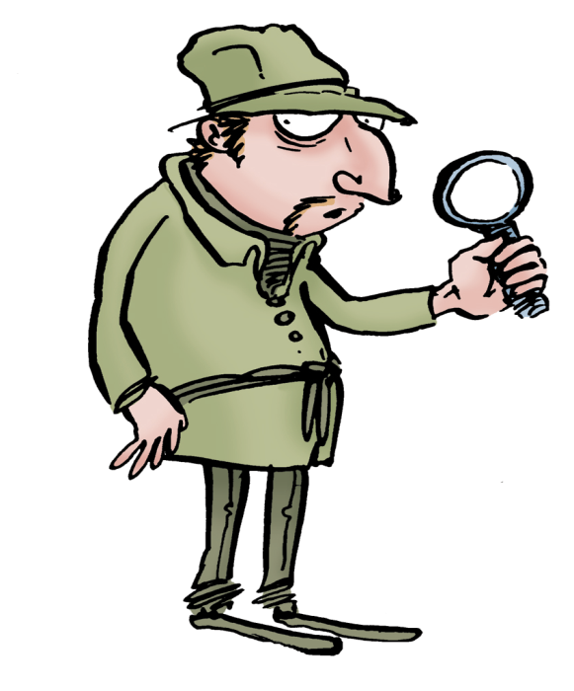
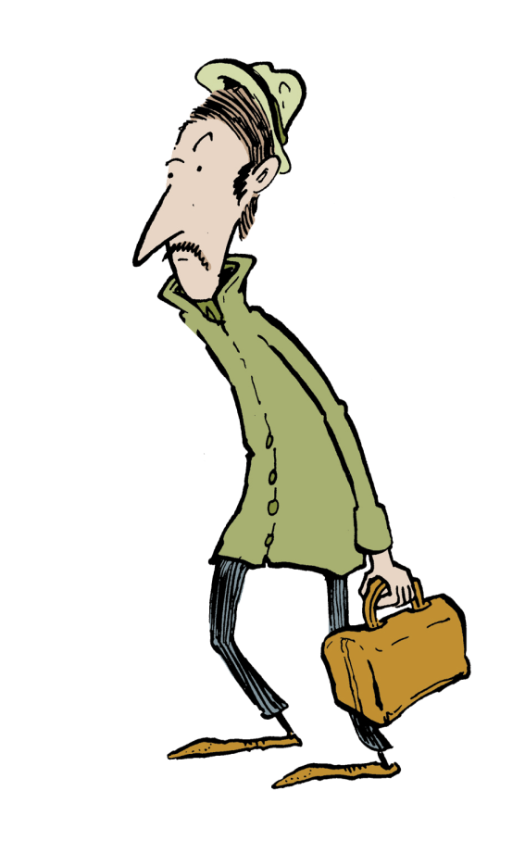
Hmm, maybe when the Bible says six days, it doesn’t mean six days?
Eh?
It’s like when I sometimes say, “I’m so thirsty I could drink a swimming pool.”
It’s using words for effect, like a poem!

Slide 10
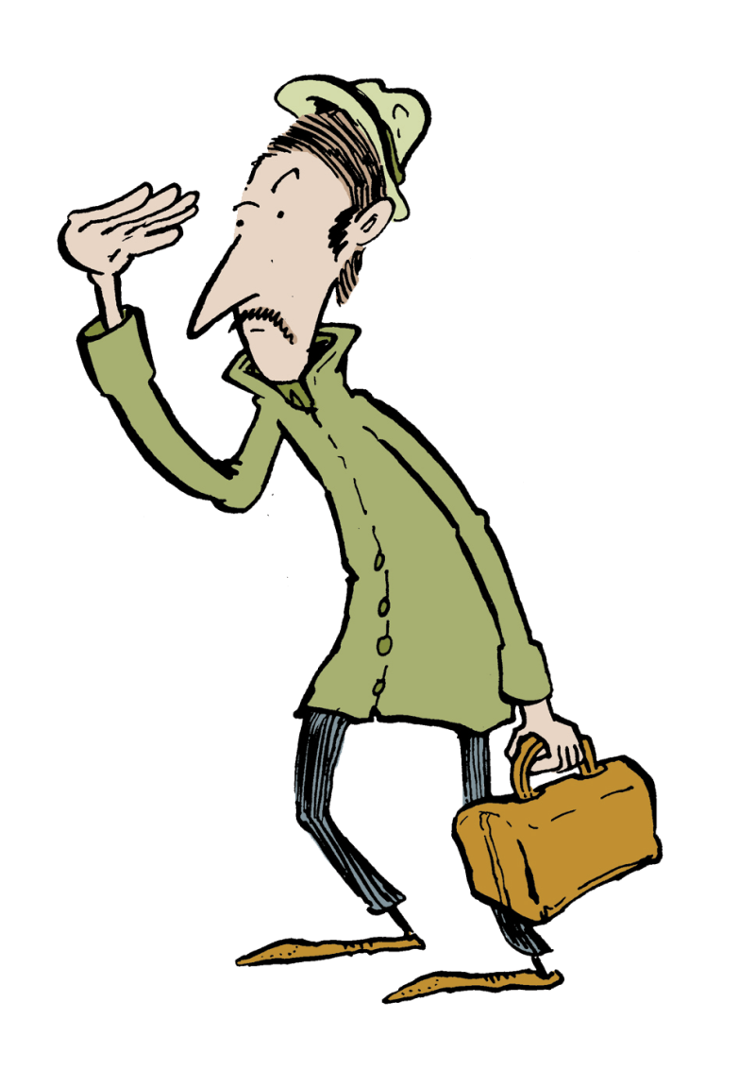

So what you’re saying is that there’s more to this Creation story than meets the eye
Exactly! It’s got several layers of meaning ... I wonder what people will make of it in the future?

Slide 11
Question 2:
Good work sleuths!
On the next page, you’ll see how one Christian understands the religious and scientific accounts, side by side.
Have a read, then answer the questions.

Slide 12
Science tells me, the Bible tells me...
Science explains that billions of years ago, matter in the Universe gathered to form stars. It also explains that on Earth, the first life began when chemicals came together in what is sometimes called, the primordial soup.
I believe this story is God’s revealed truth. It is not a scientific story but it is important for a different reason – which is the truth it tells us about God. For example the story tells us that God wants his people to have a personal relationship with him.
Questions:
What is primordial soup?
What is meant by revealed truth?

Slide 13

Where have they gone?
One of them said something about finding a time machine ... Sounds ominous!

Slide 14

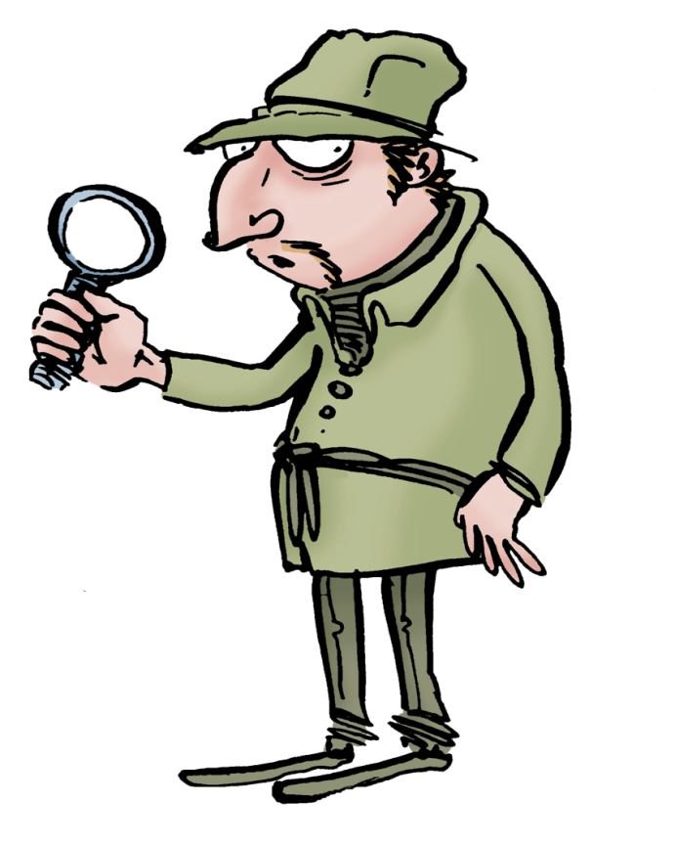
I have found the meaning of ‘revealed truth’. It means that God shared his thoughts with humans and they wrote out in their own words what He’d said.

Slide 15
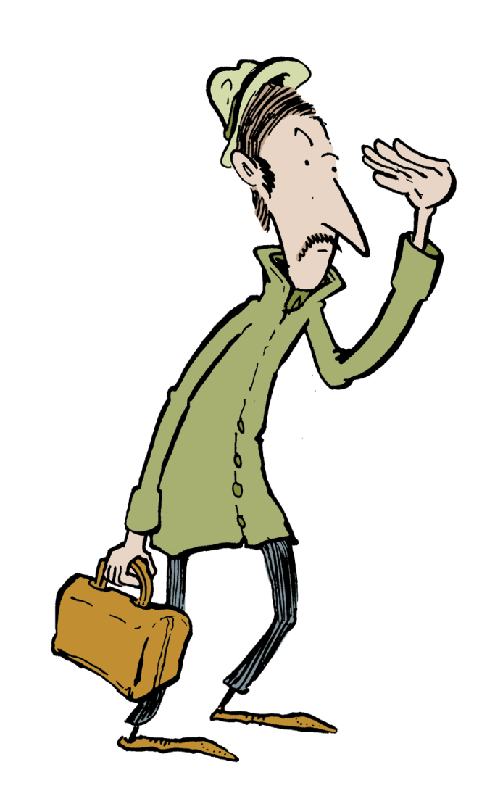


Great. And I’ve found the primordial soup. I’m standing in it in fact. It’s a rock pool on Earth millions of years ago and apparently, it’s where life began!

Slide 16
Case solved!

Slide 17
When comparing science with religion, you could take one of these approaches:
You believe EVERYTHING about creation in religious scripture. When scientists say something different, you say they are mistaken.
Literalism
You believe NOTHING about creation from scripture. You only listen to what scientists tell us.
Scientism
Open to both science and religion
You take ideas from both scripture and science. In general, science is your guide on how things work and religion tells you why everything is here.

Slide 18
And now you’ve finished this section!
Close the window and see what’s next.
OK, have a break first!!

