Slide 1
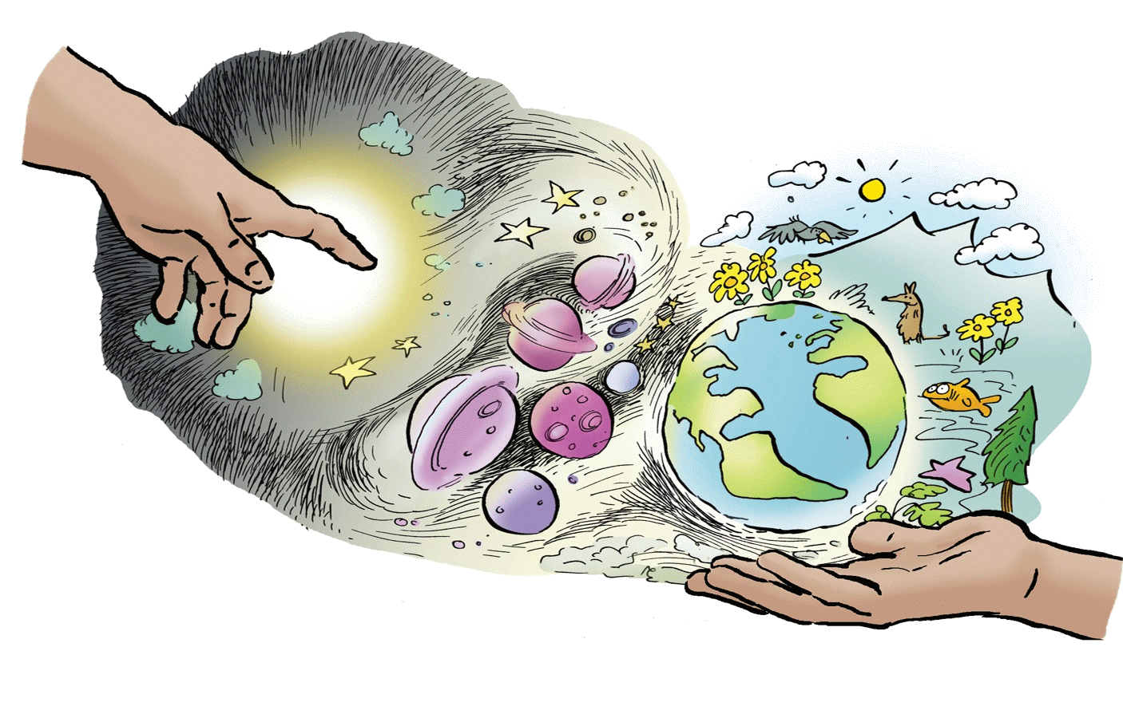


Science and Creation

Slide 2

What are we exploring?
We are looking at ways to think about science and faith together to see whether we need to choose between them.
Notes:
General introductory points for children on the topic of the presentation. Discussion points for the groups. Prompts such as what does science/faith say about life? We are now going to explore this in more detail…

Slide 3
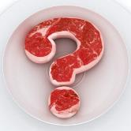
Discuss what you think?
Science has disproved God
Science cannot tell us whether or not God exists
Evolution cannot be right because religion says God made everything in six days.
Do you agree or disagree with these? Why or why not?
Notes:
Look at the statements Discuss in pairs/groups: what do we think of these statements?

Slide 4
Compare
In one sentence, describe what you understand by:
  Evolution 2. Creation
Notes:
Compare what students understand by "evolution" and in another sentence what they understand by "creation".

Slide 5
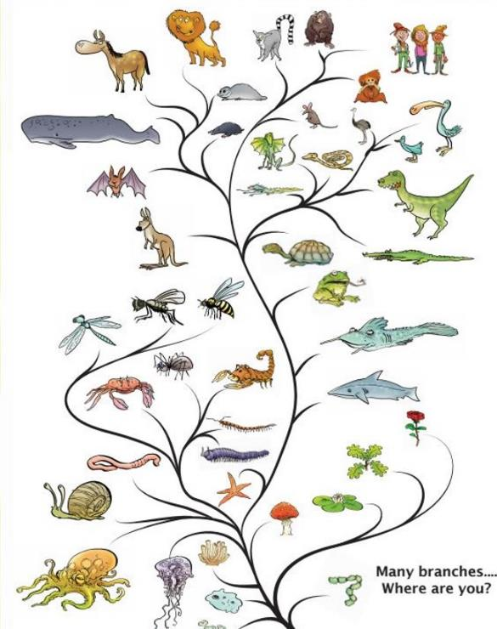
Evolution
Humans and monkeys share a common ancestor. But so does all life!
It’s like a tree, not a ladder.
Can you find any other interesting relatives?
Notes:
Wider family tree of all of life. Not just humans and monkeys share an ancestor but so does all life like a tree (not a ladder!!) Pupils often especially like the fact that dinosaurs and birds are relatives so nice one to pick up on too.

Slide 6
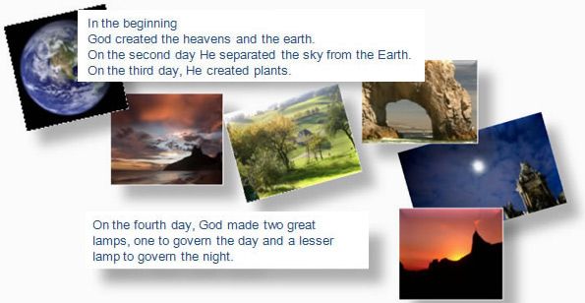
Creation
Most theologians (people who study religious texts) believe that the text is written in poetic language. They say that the writer did not intend the writing to be interpreted literally.
Notes:
Go through an Abrahamic (Christian, Islamic and Jewish) creation story such as in the Bible and draw attention to the style of writing. Ask students whether they can see why many people think the language is poetic. A religious book like the Bible contains many, many different styles. The style used in the Creation story in the Bible is called High Prose..

Slide 7


Science explains …
Science explains that billions of years ago, matter in the Universe gathered to form stars. It also explains that on Earth, the first life began when chemicals came together in what is sometimes called,the primordial soup.
The Creation story explains …
Some believe the story is God’s revealed truth. It is not a scientific story but it is important for a different reason – it says that God is the reason that everything exists. And the story tells us that God wants his people to have a personal relationship with him.

Slide 8
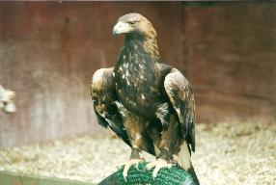
Poetic language
“The Eagle” by Tennyson
He clasps the crag with crooked hands,
Close to the sun in lonely lands;
Ring’d with the azure world he stands.
The wrinkled sea beneath him crawls;
He watches from his mountain walls
And like a thunderbolt he falls.
Notes:
Display and read out Tennyson's "Eagle"
Imagine and then display a literal interpretation over the next few slides…

Slide 9

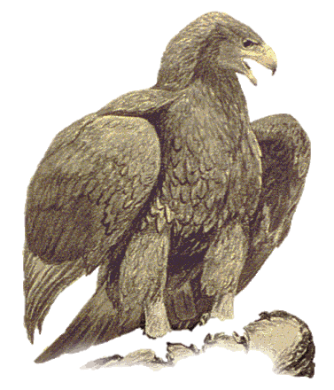


The Eagle
Close to the sun in
lonely lands
He clasps the crag with
crooked hands
Notes:
Literal interpretation of hands instead of talons? Flying close to the sun? what would happen?

Slide 10
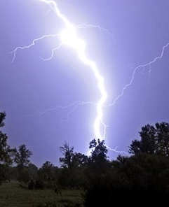

The Eagle
He watches from his mountain walls
And like a thunderbolt he falls!
Notes:
Can mountains have walls? Falling like a thunderbolt (with a loud optional “crash” if you wish). Main message to get across is the poetic imagery of the words in the Eagle.

Slide 11
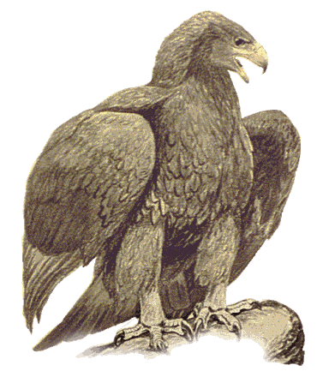
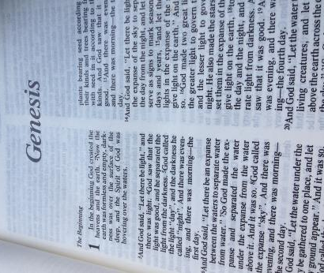
Poetic Language
Notes:
Discuss how the poetic language in the Eagle is similar to that of Genesis one and the story of creation

Slide 12
SCIENCE
FAITH
Notes:
Explain how both evolution and creation give us different understandings on how people and animals came into existence, evolution as the how and creation as the why. Does this mean that science in the sense of evolution and faith in the sense of faith need to be separated?....

Slide 13
SCIENCE
FAITH
Notes:
Or can they be combined? Open discussion with the pupils. Show of hands for both diagrams.

Slide 14

What do you think now?
Science has disproved God
Science cannot tell us whether or not there is a God
Evolution cannot be right because religion says God made everything in six days.
Do you agree or disagree with these? Why?
Notes:
Did any of them change their opinion from the same questions on slide 3? Why?

